Slide 1
W3C WoT and Auto in a nutshell - Web technology for the IoT era -
Kazuyuki Ashimura (芦村和幸)
Project Associate Professor, Graduate School of Media and Governance, Keio University
W3C Project Specialist & Staff Contact
26 April 2017

Slide 2
Web and W3C’s Standardization
Recent Topics of Web Standardization
Web of Things (WoT)
Web and Automotive
Issues and Possible Resolutions

Slide 3
Web and W3C’s Standardization

Slide 4
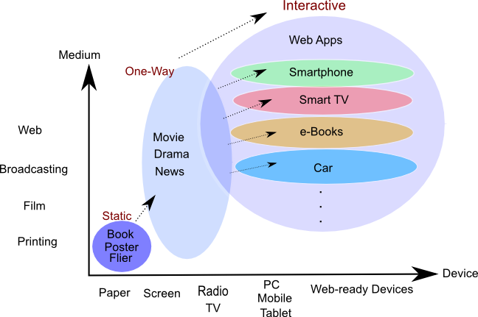
Web Evolution Application Platform independent on devices/OSs
Notes:
This is just a few of the areas where the IoT is being applied

Slide 5
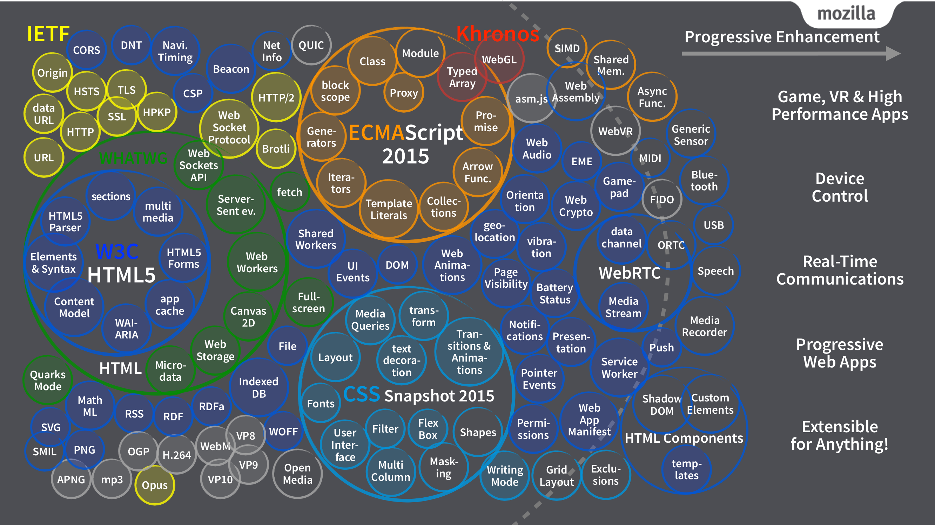
HTML5 and Fellow Specifications
(authored by Tomoya Asai, Mozilla Japan)
Notes:
This is just a few of the areas where the IoT is being applied

Slide 6
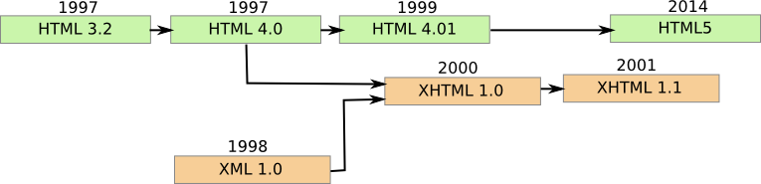
HTML5: Ver. 5 of HTML (HyperText Markup Language)
A Web page consists of HTML (syntax) and CSS (style)
W3C’s Web standards implemented on Web browsers
Notes:
This is just a few of the areas where the IoT is being applied

Slide 7
Powerful Features of HTML5
Video & Audio /wo plugins
WebSocket
Storage
Worker
Canvas
Extensibility by various APIs
Not only PCs and Smartphones but now Cars and IoT Devices
International standardization by W3C
Notes:
This is just a few of the areas where the IoT is being applied

Slide 8

International Standardization of Web Technology by W3C
Lead the Web to its full potential!
Established by Tim Berners-Lee in 1994
International industry consortium tackling Web interoperability
Various W3C Recommendation documents including HTML5
463 Member organizations from various industries
Notes:
This is just a few of the areas where the IoT is being applied

Slide 9


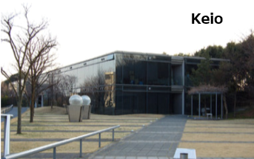

Four Host Organizations
US: MIT
Europe: ERCIM
Japan: Keio University
China: Beihang University
Notes:
This is just a few of the areas where the IoT is being applied

Slide 10
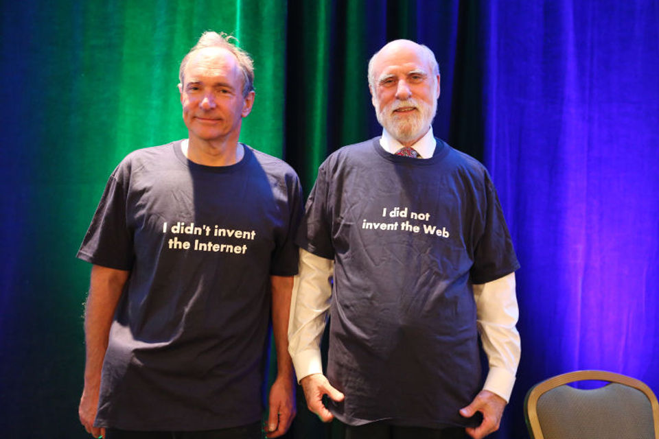
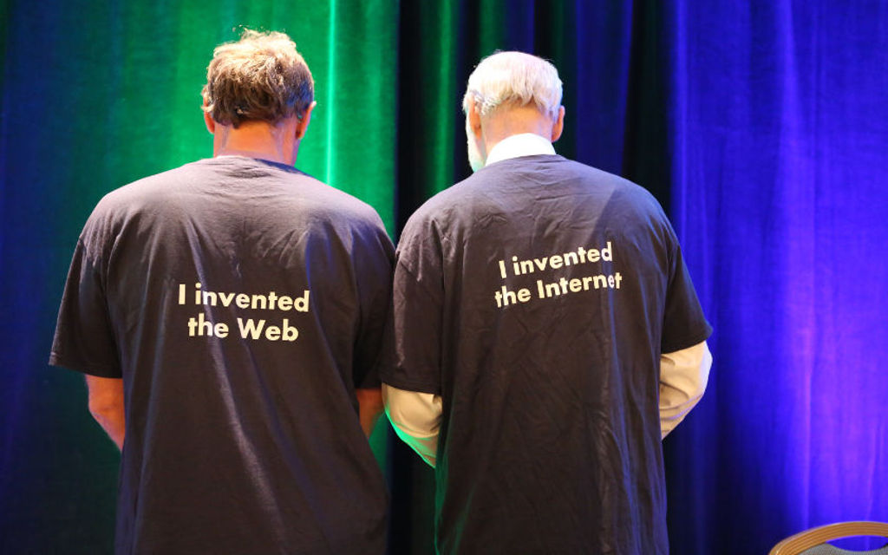
The difference between the Internet and the Web? - The Web is an information space on the Internet.
W3C/MIT Team 20th anniversary in 2014
Web inventor Tim Berners-Lee (left) and Internet inventor Vint Cerf (right)
Notes:
This is just a few of the areas where the IoT is being applied

Slide 11
Recent topics of Web standardization IoT & Connected Car

Slide 12






Massive Potential for the Internet of Things
Smart Homes
Wearables
Healthcare
Power & Environment
Smart Cities
Manufacturing
Notes:
This is just a few of the areas where the IoT is being applied

Slide 13

Horizontal-Vertical Metadata Vocabulary
Metadata vocabulary corresponds to each industry vertical
Horizontal core metadata by W3C

Slide 14
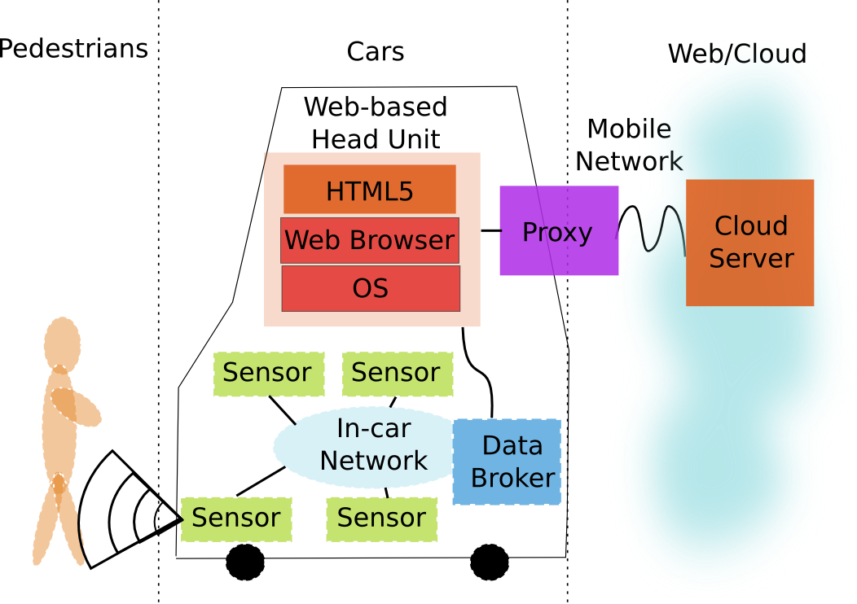
Connected Cars

Slide 15
WoT: Web of Things

Slide 16





W3C WoT Mission
Interconnect the silos ＝ de-silo
Web of Things
…
“enable easy integration across IoT platforms and application domains” “complementing available standards”

Slide 17
Key Technologies: Web Semantics, Metadata, Datamodel
Service discovery
Web semantics as a common vocabulary
Service composition
Mashing-up services provided by multiple vendors
Service monetization
Correspond to various models
Service requirements
Security, Privacy, Safety, Compliance, Trust, Recover
Service scarability
From micro controllers to massive cloud servers
Notes:
Shared use of vocabularies will streamline markets of services, but may be harder to achieve when the requirements vary from one application to another. In addition the “language” used by weakly coupled communities tend to diverge over time. This introduces friction into the market which can to some extent be offset by third parties acting as intermediaries. Best practices for vocabulary design can allow for unknown properties to be ignored when it is safe to do so. The success of Linux package management provides inspiration for techniques for ensuring interoperability across services provided by different vendors and across different communities.

Slide 18



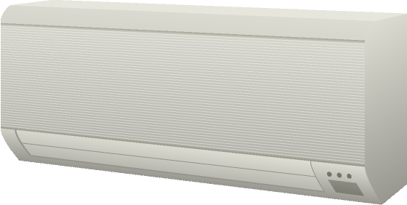
W3C WoT Framework
Local Hubs
Cloud Mirrors
Application
Remote access
Application
Device Shadow
Virtual Thing
Standardized APIs for portable application logic
(Scripting API)
Scripting API
Scripting API
Semantic metadata
(Thing Description)
Interaction Model
Interaction Model
Binding Templates
Binding Templates
Web integration
Direct Thing-to-Thing
Complementing
existing devices
and platforms
Application
Existing Device
Application
Web Browser
+
Thing
Scripting API
Scripting API
Interaction Model
(Thing Description, Binding Templates)
Interaction Model
⇒
Binding Templates
Thing
Binding Templates
Powerful and constrained Things

Slide 19
W3C WoT
Interest Group (IG)
Working Group (WG)
https://www.w3.org/2016/07/wot-ig-charter.html
Started spring 2015
218 participants
Informal work, outreach
Use cases, explorative work
Liaisons and collaborations with other organizations and SDOs
PlugFests with running code
https://www.w3.org/2016/12/wot-wg-2016.html
Started December 2016
71 participants
Normative work
Standardization of four initial building blocks identified by the IG

Slide 20
4 Key Components: W3C WoT Building Blocks
WoT Scripting API:
A standardized API to simplify IoT application development and enable portable scripts across vendors and device, gateway, and cloud platforms.
WoT Servient
Runtime Environment
WoT Thing Description (TD):
Provides metadata of the interactions, data model, communication, as well as security mechanisms of the Thing
App Script
Scripting API
TD
WoT Binding Templates:
The TD also describes the usage of protocols. A vanilla protocol stack can be configured at runtime to produce message that will be understood by the targeted.
Interaction Model
Binding Templates
Security & Privacy:
W3C WoT does not invent new mechanisms, but ensures that all building blocks provide means to describe the security and privacy mechanisms used in a specific platform and provides adversary testing of Things.
Server
Client

Slide 21
WoT Thing Description
Describe Thing, communication, and security metadata
https://w3c.github.io/wot-thing-description/

Slide 22
TD Example
JSON-LD (Linked Data)
W3C WoT TD vocabulary
{
"@context": [
"http://w3c.github.io/wot/w3c-wot-td-context.jsonld",
{ "domain": "http://example.org/actuator#" }
],
"@type": "Thing",
"name": "MyLEDThing",
"base": "coap://myled.example.com:5683/",
"security": {
"cat": "token:jwt",
"alg": "HS256",
"as": "https://authority-issuing.example.org"
},
"interactions": [
{
"@type": ["Property", "domain:onOffStatus"],
"name": "status",
"outputData": {"valueType": {"type": "boolean"}},
"writable": true,
"links": [
{
"href": "pwr",
"mediaType": "application/exi"
},
{
"href": "http://mytemp.example.com:8080/status",
"mediaType": "application/json"
}
]
},
{
"@type": ["Action", "domain:fadeIn"],
"name": "fadeIn",
"inputData": {
"valueType": {"type": "integer"},
"domain:unit": "domain:ms"
},
"links": [
{
"href": "in",
"mediaType": "application/exi"
},
{
"href": "http://mytemp.example.com:8080/in",
"mediaType": "application/json"
}
]
},
{
"@type": ["Action", "domain:fadeOut"],
"name": "fadeOut",
"inputData": {
"valueType": {"type": "integer"},
"domain:unit": "domain:ms"
},
"links": [
{
"href": "out",
"mediaType": "application/exi"
},
{
"href": "http://mytemp.example.com:8080/out",
"mediaType": "application/json"
}
]
},
{
"@type": ["Event", "domain:alert"],
"name": "criticalCondition",
"outputData": {"valueType": {"type": "string"}},
"links": [
{
"href": "ev",
"mediaType": "application/exi"
}
]
}
]
}
domain-specific vocabulary
JSON Schema

Slide 23
{
"@context": [
"http://w3c.github.io/wot/w3c-wot-td-context.jsonld",
{ "domain": "http://example.org/actuator#" }
],
"@type": "Thing",
"name": "MyLEDThing",
"base": "coap://myled.example.com:5683/",
"security": {
"cat": "token:jwt",
"alg": "HS256",
"as": "https://authority-issuing.example.org"
},
"interactions": [
{
"@type": ["Property", "domain:onOffStatus"],
"name": "status",
"outputData": {"valueType": {"type": "boolean"}},
"writable": true,
"links": [
{
"href": "pwr",
"mediaType": "application/exi"
},
{
"href": "http://mytemp.example.com:8080/status",
"mediaType": "application/json"
}
]
},
{
"@type": ["Action", "domain:fadeIn"],
"name": "fadeIn",
"inputData": {
"valueType": {"type": "integer"},
"domain:unit": "domain:ms"
},
"links": [
{
"href": "in",
"mediaType": "application/exi"
},
{
"href": "http://mytemp.example.com:8080/in",
"mediaType": "application/json"
}
]
},
{
"@type": ["Action", "domain:fadeOut"],
"name": "fadeOut",
"inputData": {
"valueType": {"type": "integer"},
"domain:unit": "domain:ms"
},
"links": [
{
"href": "out",
"mediaType": "application/exi"
},
{
"href": "http://mytemp.example.com:8080/out",
"mediaType": "application/json"
}
]
},
{
"@type": ["Event", "domain:alert"],
"name": "criticalCondition",
"outputData": {"valueType": {"type": "string"}},
"links": [
{
"href": "ev",
"mediaType": "application/exi"
}
]
}
]
}
Property
Action

Slide 24
{
"@context": [
"http://w3c.github.io/wot/w3c-wot-td-context.jsonld",
{ "domain": "http://example.org/actuator#" }
],
"@type": "Thing",
"name": "MyLEDThing",
"base": "coap://myled.example.com:5683/",
"security": {
"cat": "token:jwt",
"alg": "HS256",
"as": "https://authority-issuing.example.org"
},
"interactions": [
{
"@type": ["Property", "domain:onOffStatus"],
"name": "status",
"outputData": {"valueType": {"type": "boolean"}},
"writable": true,
"links": [
{
"href": "pwr",
"mediaType": "application/exi"
},
{
"href": "http://mytemp.example.com:8080/status",
"mediaType": "application/json"
}
]
},
{
"@type": ["Action", "domain:fadeIn"],
"name": "fadeIn",
"inputData": {
"valueType": {"type": "integer"},
"domain:unit": "domain:ms"
},
"links": [
{
"href": "in",
"mediaType": "application/exi"
},
{
"href": "http://mytemp.example.com:8080/in",
"mediaType": "application/json"
}
]
},
{
"@type": ["Action", "domain:fadeOut"],
"name": "fadeOut",
"inputData": {
"valueType": {"type": "integer"},
"domain:unit": "domain:ms"
},
"links": [
{
"href": "out",
"mediaType": "application/exi"
},
{
"href": "http://mytemp.example.com:8080/out",
"mediaType": "application/json"
}
]
},
{
"@type": ["Event", "domain:alert"],
"name": "criticalCondition",
"outputData": {"valueType": {"type": "string"}},
"links": [
{
"href": "ev",
"mediaType": "application/exi"
}
]
}
]
}
Event (under construction, sources, sinks, …)

Slide 25
WoT Thing Description
JSON-LD is just one possible representation
Good for discussion, accepted by Web people
TD is a semantic model
Backed by RDF and Linked Data vocabularies
Yet complexity of Semantic Web can be ignored
Other formats possible
EXI, CBOR, … for machines
Custom application/wot-td+json for developers
Just serializations of the semantic model

Slide 26
WoT Scripting API
Program and deploy IoT applications like Web applications
https://w3c.github.io/wot-scripting-api/

Slide 27
Script Example (Expose Thing)
// create software object to represent local Thing
WoT.newThing("counter")
.then( (thing) => {
thing
// programmatically add interactions (builder pattern)
.addProperty("count", {"type": "integer"}) // JSON Schema
.addAction("increment")
.onInvokeAction("increment", () => {
console.log("incrementing counter");
// persistent state is managed by runtime environment
let value = thing.getProperty("count") + 1;
thing.setProperty("count", value);
return value;
});
// initialize state (transparent if local or remote Thing)
thing.setProperty("count", 0);
})
.catch(console.err);

Slide 28
Script Example (Consume Thing)
// create software object to represent remote Thing based on TD URI
WoT.consumeDescriptionUri("http://servient.example.com/things/counter")
// use promise to handle asynchronous creation
.then( (counter) => {
counter
// invoke an Action without arguments
.invokeAction("increment")
// which is an asynchronous call -> promise
.then( () => {
console.log("incremented");
counter
// read Property (async.) to confirm increment
.getProperty("count").then( (count) => {
console.log("new state is " + count);
});
}).catch(console.error);
})
.catch(console.error);

Slide 29
WoT Scripting API
Standard API for IoT applications (cf. Web browser)
Discovery with different mechanisms
Client to remote Things and local hardware
Server for remote Things
Hiding state management and asynchronicity
Initial focus on JavaScript (Web of Things)
Aiming to keep API definition language-agnostic
Possible other APIs in the future (e.g., Lua)

Slide 30
W3C WoT Roadmap
https://www.w3.org/WoT/IG/wiki/Roadmap

Slide 31
W3C WoT Task Forces
IG
Current Practices (has deliverable)
Testing (PlugFest scenarios)
Thing Lifecycle
Synchronization of Servients
Linked Data and Semantic Processing
Demonstrators (You’re wanted ☺)
WG
Architecture (has deliverable)
Thing Description (has deliverable)
Type System (JSON Schema Extensions)
Hypermedia (Actions, error handling, …)
Scripting API (has deliverable)
Binding Templates (has deliverable)
Security & Privacy

Slide 32
W3C WoT Liaisons
IETF / IRTF
Established, joint meetings since Nov 2015
Open Connectivity Foundation (OCF)
Established, active alignment and joint PlugFest coming up
oneM2M
Established, commonality identified and preparing input
OPC Foundation
Established, need to agree on strategy etc.
Plattform Industrie 4.0
Initial conference calls
OpenFog
Initial outreach

Slide 33
WG Roadmap
2017-02 (Santa Clara F2F)
Create GitHub repos
2017-05 (Osaka F2F)
Graphical and RDF model of TD
Editor’s Drafts
RC for WoT Architecture First Public Working Draft (FPWD)
Start security review for WoT Architecture
2017-07 (Düsseldof F2F)
Finish security review for WoT Arch. with Internet Drafts (“security concepts”) for internal security review and IETF outreach
Draft for test suite (Servient emulator with automatic checks)
Release First Public Working Draft (FPWD) of WoT Architecture

Slide 34
WG Roadmap
2017-11 (TPAC 2017, Burlingame, CA, USA)
RCs for First Public Working Drafts
RC Implementations and Test Suite
Start security review
2018-03 (London? F2F)
Finish security review
Release First Public Working Drafts (FPWDs)
2018-05 (F2F at sec conf, Santa Clara?)
Aggressive testing / adverse security testing?
2018-07 (China? F2F)

Slide 35
WG Roadmap
2018-10
RCs for Candidate Recommendations
Start security review
2018-11 (TPAC 2018, Asia?)
Finish security review
Start release process
2018-12 (end of current charter)
Release Candidate Recommendations (CRs)

Slide 36
W3C WoT Online Resources
W3C WoT Interest Group
https://www.w3.org/WoT/IG/ (blog)
https://www.w3.org/2016/07/wot-ig-charter.html (charter)
https://lists.w3.org/Archives/Public/public-wot-ig/ (subscribe to mailing list)
W3C WoT Working Group
https://www.w3.org/WoT/WG/ (dashboard)
https://www.w3.org/2016/12/wot-wg-2016.html (charter)
W3C WoT Wiki (IG+WG organizational information)
https://www.w3.org/WoT/IG/wiki/Main_Page
W3C WoT GitHub (IG technical proposals)
https://github.com/w3c/wot
W3C WoT WG Documents
https://w3c.github.io/wot-architecture/
https://w3c.github.io/wot-thing-description/
https://w3c.github.io/wot-scripting-api/
https://w3c.github.io/wot-binding-templates/

Slide 37
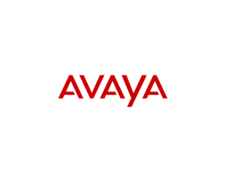




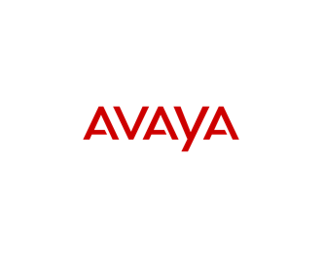










Web of Things Participants

Slide 38
Web & Automotive

Slide 39
Connected Cars

Slide 40
Why Web?
Drastic change of car industry
Software getting more and more important
Cost for development and maintenance
Expectation for open standards and Web technology
W3C’s Web standardization
Web-based IVI (In-vehicle Infortainment)
Access API + Data definition
Liaison: GENIVI, Tizen, Webinos, QNX, …

Slide 41
F2F Meetings – Incubation by Business Group
14-15 November 2012: Rome, Italy (W3C Workshop)
22 April 2013: Barcelona, Spain
29 May 2013: Tokyo, Japan
17-18 March 2014: Santa Clara, US
22-23 May 2014: Gothenburg, Sweden
9-10 October 2014: Ann Arbor, US
24 April 2015: Stuttgart, Germany
22 October 2015: Seoul, Korea

Slide 42
F2F Meetings – Standardization by Working Group
23-24 April 2015: Stuttgart, Germany
28-29 July 2015: Seattle, US
26-27 October 2015: Sapporo, Japan
28-29 April 2016: Paris, France
26-28 July 2016: Portland, US
19-20 September 2016: Lisbon, Portugal
20-21 October 2016: Burlingame, US
9-11 May 2017: Birmingham, UK

Slide 43
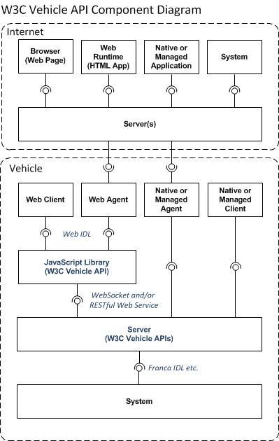
Vehicle Signal Architecture

Slide 44
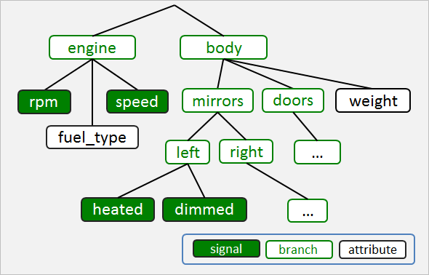
Vehicle Signal Spec (VSS) by GENIVI

Slide 45
Other work related to Web&Automotve
Security and Privacy Guideline:
https://www.w3.org/auto/security/wiki/ASP_TF
Location-based Service:
https://www.w3.org/community/autowebplatform/wiki/LBSTaskForce
Media Tuner:
https://www.w3.org/community/autowebplatform/wiki/MediaTunerTaskForce
2nd generation Vehicle Information Service:
https://www.w3.org/community/autowebplatform/wiki/ViWi
RESTful Service Interface:
https://www.w3.org/community/autowebplatform/wiki/RSITaskForce

Slide 46
Issues and possible Resolutions

Slide 47
Technical Issues: Semantic Interoperability
Thing Description: Meta framework independent from programming languages or protocols
Interoperability with existing programming languages, protocols and Web technologies
JSON, C Language, Java, etc.
REST, HTTP, CoAP, MQTT, etc.
RDF, Schema.org, WebAssembly, EXI, etc.
Combination of Property, Action and Event
Event handling
State transition and time synchronization
Device lifecycle and maintenance

Slide 48
Security, Privacy and Safety
WoT is linked with physical devices
→ Security, Privacy and Safety are even more important than usual Web applications
→ Panel discussion during the W3C/Keio Team 20th anniversary event (https://www.w3.org/20/Asia/Japan/Overview.ja.html)
→ Formed the Security TF for dedicated discussion
Q1: Security architecture for WoT?
Viewpoint: Something like human immune system?
Q2: Clarifying “possible risks”?
Viewpoint: Cost efficiency should be also considered (frequency, damage, scale)?
Q3: Expected solution/improvement?
Viewpoint: Different kind/level of solutions are needed depending on the nature of the issues (technical vs non-technical)

Slide 49









Liaison with other SDOs
Related SDOs working on IoT topics
INDUTRIE 4.0
Industrial Internet Consortium
Open Connectivity Foundation
OPC Foundation
IETF/IRTF
oneM2M
AIOTI
Etc.
AIOTI
Notes:
We’ve set up a collaboration agreement with the IIC which is not an standards organisation itself. The Open Connectivity Foundation is a recently announced rebranding on the Open Interconnect Consortium (OIC). We’ve had presentations from OIC and likewise given presentations to the OIC. OIC started with Intel, Samsung, Cisco and others, then brought in Microsoft for their work on UPnP, and with the rebranding as OCF, have now brought in Qualcomm. We’ve had quite a few meetings with Industrie 4.0 and they generally agree with our approach. We’re having discussions with the OPC Foundation, e.g. in respect to semantic interoperability and security frameworks. W3C has good links with the IETF and its sibling the IRTF (Internet Research Task Force), particulary the IRTF’s Thing to Thing Research Group. We have good connections to OneM2M especially in regards to semantic interoperability. AIOTI was set up as a public-private partnership between the European Commission and Industry in respect to European funding for IoT. We’re working with AIOTI on semantic interoperability.

Slide 50
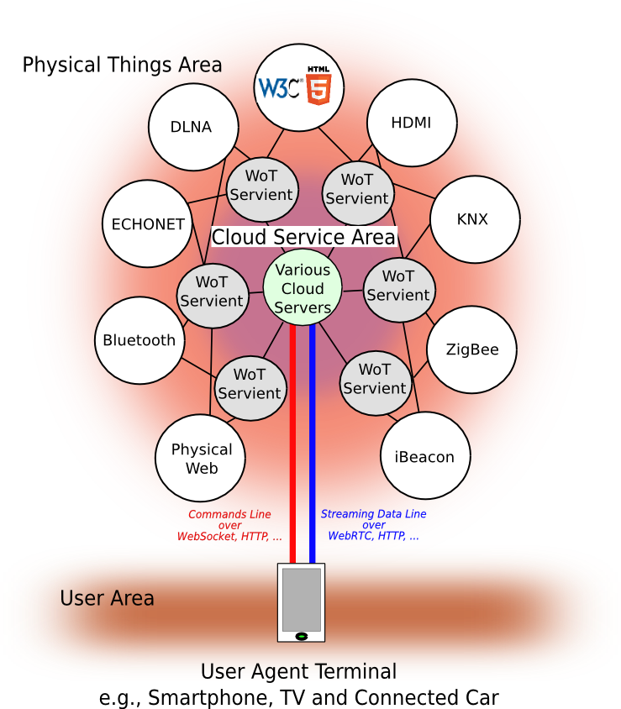
IoT Ecosystem using WoT Architecture ー WoT as “Conecters” for existing IoT frameworks

Slide 51
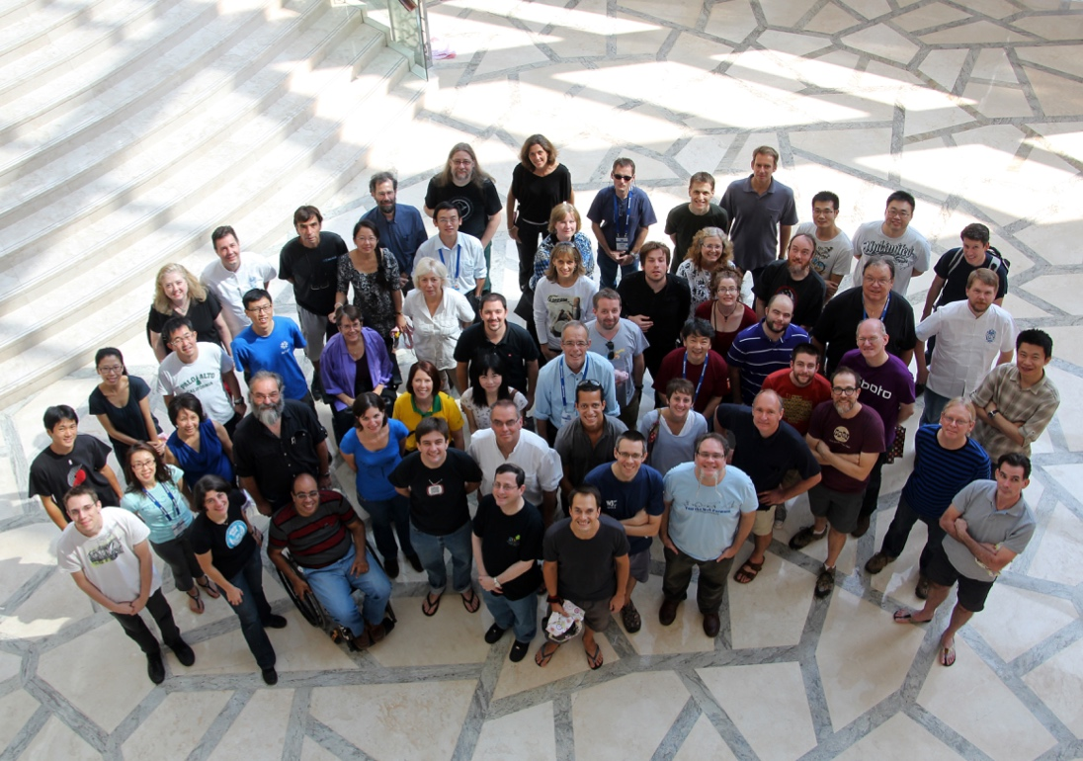
Thanks a lot!
Let’s create the future of the Web with W3C!
Notes:
Image: show human to human

